Slide 1
File I/O

Slide 2

Files
A java application can read and write to the host file system:
restricted to the same access level as the user running the JVM
can also be restricted by the security policy
The host file system lies outside of Java's virtual environment
This means programmer must deal with platform differences

Slide 3
java.io.File
An abstract representation of file and directory pathnames
An abstract pathname has two components:
An optional system-dependent prefix string, such as a disk-drive specifier, / for the UNIX root directory, or \\ (“\\\\”) for a Microsoft Windows UNC (Uniform Naming Convention) pathname, and
A sequence of zero or more string names
The File class does not read or write data
A File object encapsulates the properties of a file or a path, but does not contain the methods for reading/writing data from/to the file

Slide 4
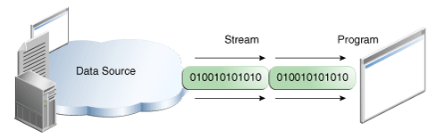
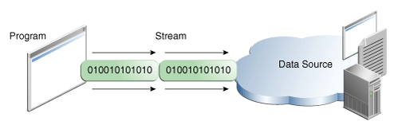
I/O Streams
Java programs perform I/O through streams
A stream is an abstraction that either produces or consumes data
A stream is linked to a physical device by the Java I/O system
All streams behave the same manner, even if the actual physical devices differs (disk file, keyboard, network socket)

Slide 5
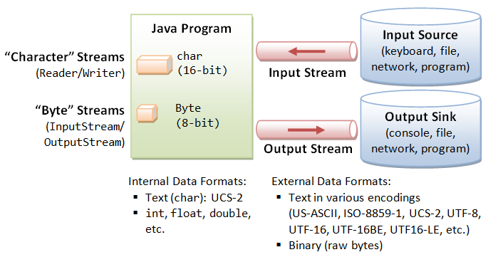
Text Files vs. Binary Files
Data stored in a text file are represented in human-readable form, ex. in a text editor
Data stored in a binary file are represented in binary form; binary files are designed to be read by programs, ex. photo app
One advantage of binary files is that they are more efficient to process than text files as they don’t need to be converted

Slide 6
I/O Streams
InputStream
defines lowest level interface for all byte input streams
defines basic functionality for reading an unstructured sequence of bytes
OutputStream
defines lowest level interface for all byte output streams
defines basic functionality for writing an unstructured sequence of bytes

Slide 7
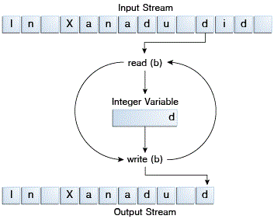
ByteStreams
See CopyBytes
CopyBytes spends most of its time in a simple loop that reads the input stream and writes the output stream, one byte at a time
Byte streams should only be used for the most primitive I/O
Note! Always close streams
Duration: 309 ms
CopyBytes

Slide 8
BufferedInputStream/BufferedOutputStream
Use buffers to speed up I/O
A buffer, also called buffer memory, is a portion of a computer's memory that is set aside as a temporary holding place for data that is being sent to or received from an external device, such as a hard disk drive (HDD), keyboard or printer
app: a b c
app: a b c
3 fast i/o operations
3 slow i/o operations
buffer: a b c
1 slow i/o operation
disk: a b c
disk: a b c

Slide 9
FileInputStream/FileOutputStream
BufferedInputStream input = new BufferedInputStream(new FileInputStream(sourceFile));
BufferedOutputStream output = new BufferedOutputStream(new FileOutputStream(targetFile));
System.out.println("The file " + args[0] + " has " + input.available() + " bytes");
// Continuously read a byte from input and write it to output
int r;
while ((r = input.read()) != -1) {
output.write((byte) r);
}
// Close streams
input.close();
output.close();
The file dcart10.txt has 130579 bytes
Copy done!
Duration: 12 ms
Compared to 309 ms without buffers
FileCopy

Slide 10
Line-Oriented Streams
Character I/O usually occurs in bigger units than single characters; one common unit is the line: a string of characters with a line terminator at the end
A line terminator can be a carriage-return/line-feed sequence ("\r\n"), a single carriage-return ("\r"), or a single line-feed ("\n")
Supporting all possible line terminators allows programs to read text files created on any of the widely used operating systems
Invoking readLine returns a line of text with the line
CopyLines

Slide 11
Getting Input Using Scanner
1. Create a Scanner object
Scanner scanner = new Scanner(System.in);
2. Use the methods next(), nextByte(), nextShort(), nextInt(), nextLong(), nextFloat(), nextDouble(), or nextBoolean() to obtain to a string, byte, short, int, long, float, double, or boolean value. For example,
System.out.print("Enter a double value: ");
Scanner scanner = new Scanner(System.in);
double d = scanner.nextDouble();
> TestScanner

Slide 12
Reading and Writing Text Files
int i = 0;
while (scanner.hasNext()) {
String row = scanner.nextLine();
System.out.println(row);
output.format("%d. %s%n", ++i, row);
}
ReadFileUsingScanner

Slide 13
Reading Text Files - alternative
try (BufferedReader br = new BufferedReader(new FileReader(fileName))) {
String line;
while ((line = br.readLine()) != null) {
System.out.println(line);
}
} catch (IOException e) {
e.printStackTrace();
}
Yes, I know, too many options!
You'll have to decide what's best in a particular situation
Sorry about that!
(If programming was easy, everyone would do it)

Slide 14
PrintStream Test (println)
import java.io.*;
public class PrintStreamer {
public static void main (String args[]) {
try {
FileOutputStream fileOut = new FileOutputStream("out.txt");
PrintStream out = new PrintStream(fileOut);
for (int i = 0; i < 10; i++) {
out.print("red");
out.print("\t");
out.println("car");
}
out.close();
}
catch (IOException e) {
System.out.println(e.getMessage());
}
}
}
"red"
PrintStream
FileOutputStream
out.txt file

Slide 15
Formatter
Scanner input = new Scanner(new File("temp.txt"));
System.out.println(input.nextLine());
Formatter output = new Formatter("temp.txt");
output.format("%s", "Java 101");
output.close();

Slide 16
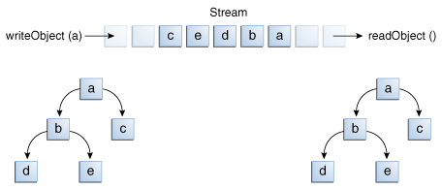
ObjectOutputStream / ObjectInputStream
specialized stream filters to serialize/deserialize objects
allow object syntax in programs:
read(Object obj)
write(Object obj)

Slide 17
ObjectOutputStream
java.io.ObjectOutputStream class is designed to handle the serialization process
writeObject(Object obj) method does actual writing. obj must be created from a class that implements Serializable interface.
Fields prefixed with transient key word are not written:
transient marks data that is meaningless after being re-created (e.g. contents of a folder, system date)

Slide 18
Using Object Streams
You may wrap an ObjectInputStream/ObjectOutputStream on any InputStream/OutputStream using the following constructors:
// Create an ObjectInputStream
public ObjectInputStream(InputStream in)
// Create an ObjectOutputStream
public ObjectOutputStream(OutputStream out)
TestObjectOutputStream
TestObjectInputStream

Slide 19
The Serializable Interface
An object that can be written to an object stream is said to be serializable
A serializable object implements the java.io.Serializable interface
The Serializable interface is a marker interface - it has no methods, so you don't need to add additional code in your class that implements Serializable
Implementing this interface enables the Java serialization mechanism to automate the process of storing the objects and arrays

Slide 20
Object Serialization
The ability to save/send objects and restore/receive objects
Serialization is the act of writing an object’s class name and attribute values to a stream (includes reference attributes)
Deserialization is the act of reading an object’s class name and attribute values (including reference attributes) from a stream:
creating a new object from the class name and attributes
assigning the field values to the new object’s fields.

Slide 21
The transient Keyword
public class TransientEx implements Serializable {
private int v1;
private static double v2;
private transient A v3 = new A();
}
class A { } // A is not serializable
When an object of the TransientEx class is serialized, only variable v1 is serialized
v2 is not serialized because it is a static variable
v3 is not serialized because it is marked transient; if v3 were not marked transient, a NotSerializableException would occur

Slide 22
Serialization Example
Movies.java
Serialize.java
DeSerialize.java

Slide 23

De-serialization results
Reconstructed object from movies.out
NAME=Drama VALUE=Elizabeth I
NAME=Action VALUE=The Bourne Identity
NAME=Comedy VALUE=Ferris Bueller's Day Off
NAME=Cartoon VALUE=Shrek

Slide 24
Simple Readable Persistence
XMLEncoder and XMLDecoder provide a simple, readable mechanism for storing and retreiving data
The XMLEncoder class is a complementary alternative to the ObjectOutputStream and can used to generate a textual representation of a JavaBean
The XMLDecoder class is used to read XML documents created using the XMLEncoder and is used just like the ObjectInputStream.

Slide 25
XMLEncoder
XMLEncoder e = new XMLEncoder( new BufferedOutputStream( new FileOutputStream("Test.xml")));
e.writeObject(myArrayList);
e.close();

Slide 26
XMLDecoder
XMLDecoder decoder = new XMLDecoder( new BufferedInputStream( new FileInputStream("Test.xml")));
myArrayList result = (ArrayList) decoder.readObject();
decoder.close();

Slide 27
Random Access Files
All of the streams you have used so far are known as read-only or write-only streams.
The external files of these streams are sequential files that cannot be updated without creating a new file.
It is often necessary to modify files or to insert new records into files.
Java provides the RandomAccessFile class to allow a file to be read from and write to at random locations.
We won't cover random access files – if you need to use them, you probably need a database

